Slide 1
ZOMATO P898 Restaurant Analytics & Market Insights Analyzing Trends | Optimizing Services | Driving Growth Done By: Mr. Karan Madav Mrs. Raksha Mishra Mr. Kartik Sharma Mr. Vishal Garg Mr. Aditya Kamble Mrs. Vidya Bharti

Slide 2

INTRODUCTION
The Zomato P898 project was executed using four core tools, each serving a distinct purpose in the data analysis workflow:
Excel was used for data cleaning and preprocessing, including handling special characters, removing duplicates, and formatting columns to ensure consistency.
MySQL supported query-based analysis, enabling data extraction through joins, filters, and aggregations to uncover insights like top cuisines, regional distribution, and service types.
Power BI was applied to build an interactive dashboard, presenting key metrics such as restaurant count, average cost, and service availability using DAX measures, slicers, and drill-through navigation.
Tableau was utilized to design a visually dynamic dashboard with maps, pie charts, and bar graphs that highlighted cuisine trends, city-wise data, and booking preferences.
Together, these tools enabled end-to-end analysis, from raw data preparation to actionable visual insights.

Slide 3
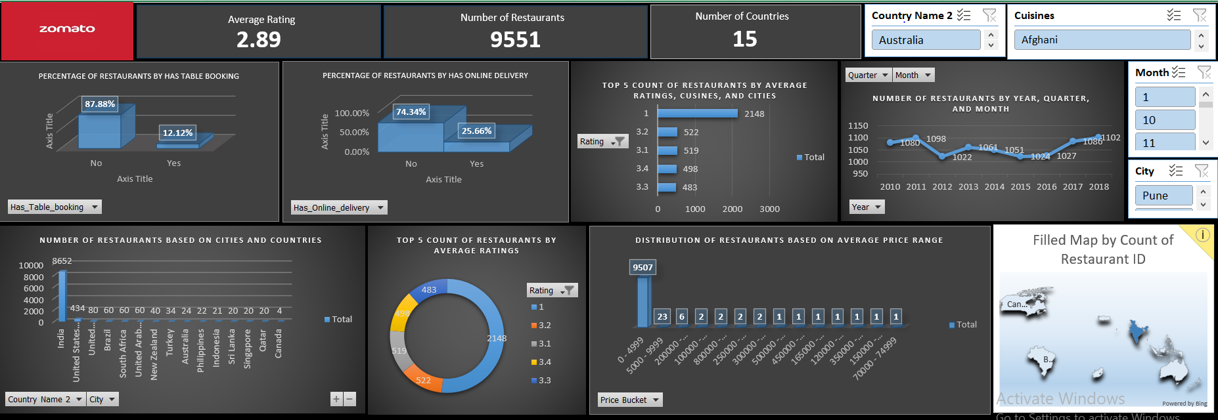
EXCEL Dashboard
This Excel dashboard offers interactive insights for better data analysis. It showcases key performance metrics in a clear, organized way. Dynamic charts and tables help users visualize trends effortlessly.

Slide 4
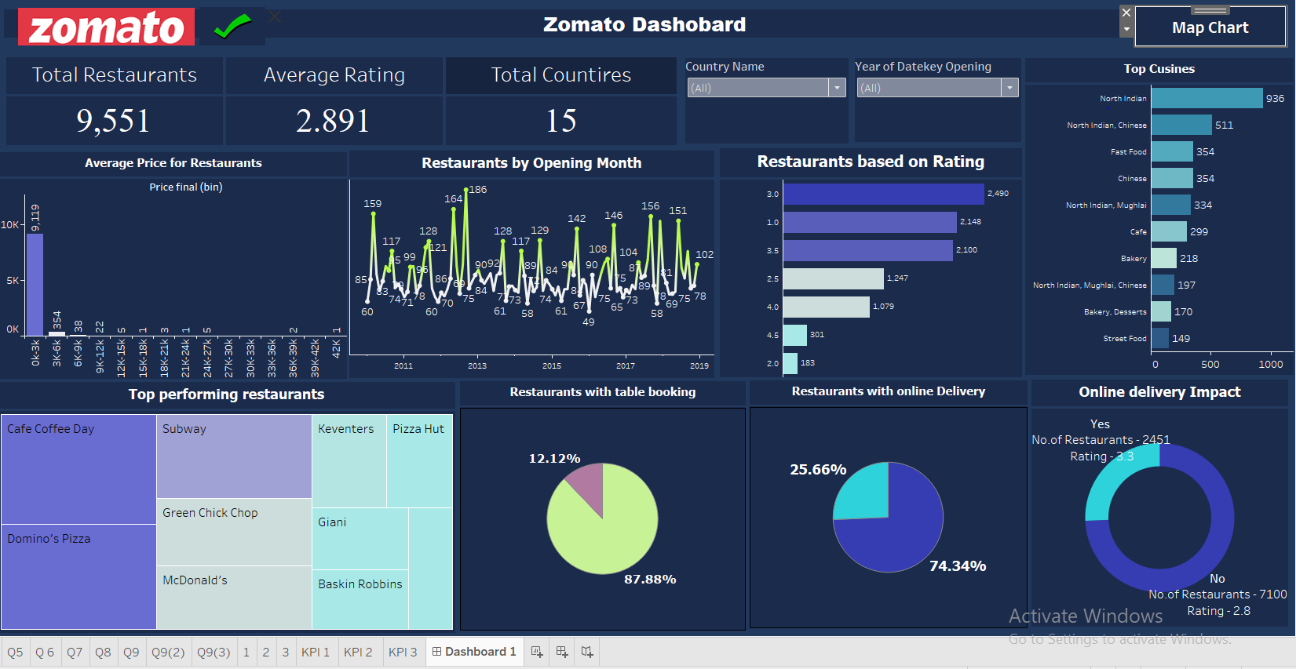
Tableau Dashboard
This Tableau dashboard is used to visualize restaurant trends with interactive maps, dynamic filters, and drill-down capabilities for deeper insights. Tableau enables seamless data blending, advanced visual storytelling, and intuitive exploration of service availability, pricing, and growth patterns.

Slide 5
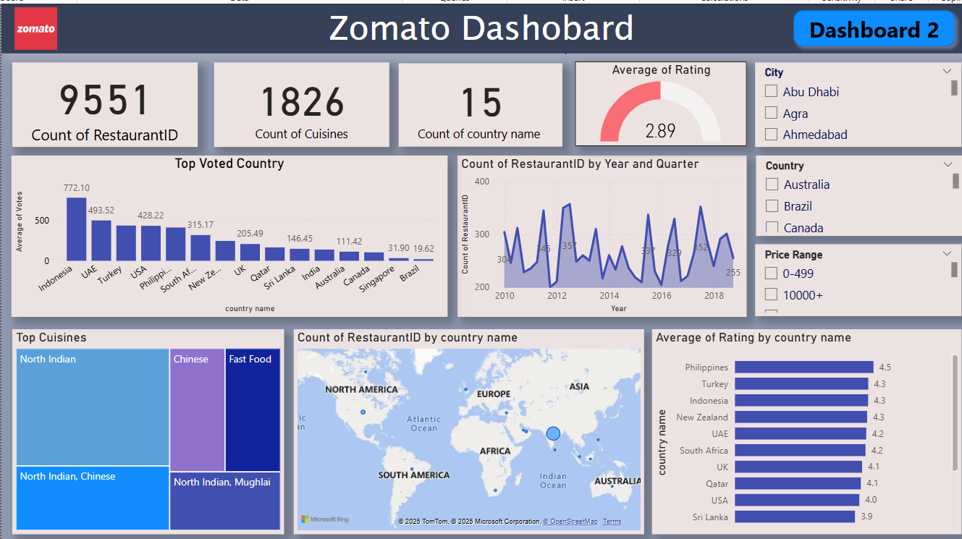
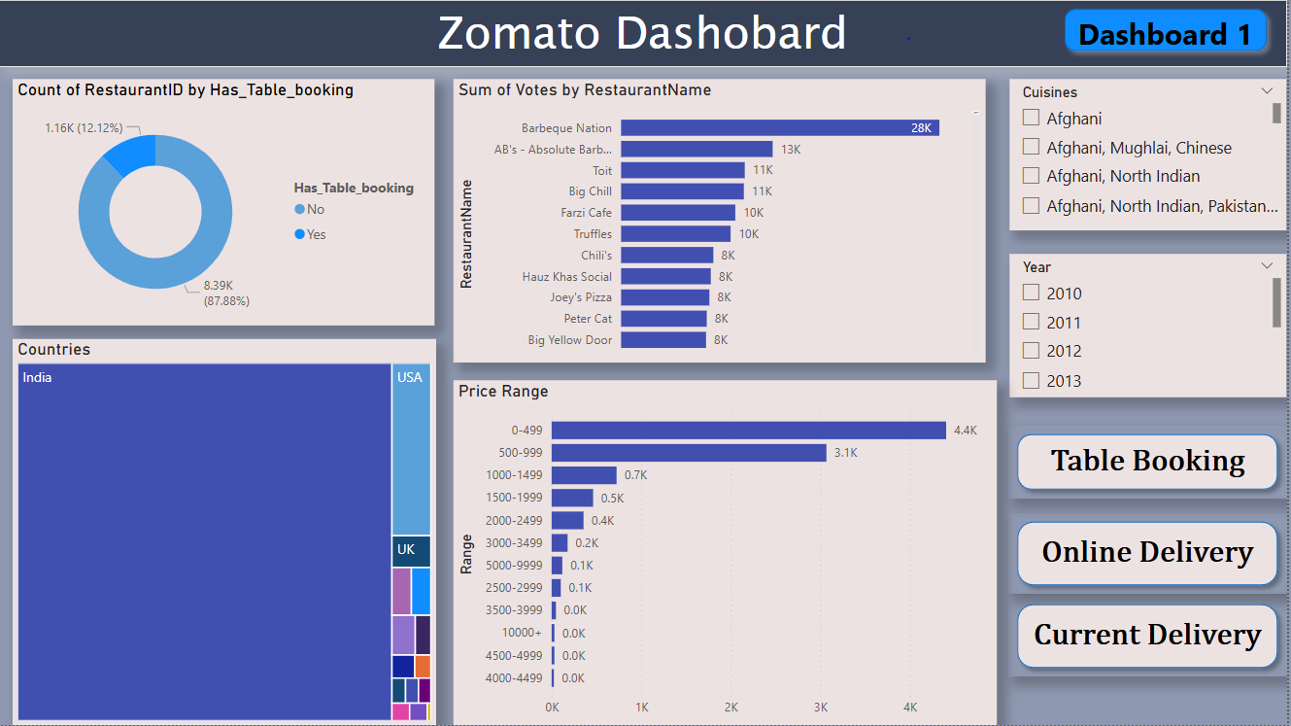
PowerBI Dashboard
This Power BI dashboard is used to analyze restaurant trends with interactive visuals, dynamic filtering, and real-time insights for better decision-making. Power BI enables data connectivity, transformation, and visualization, making it easier to explore service availability, pricing, and growth patterns.

Slide 6
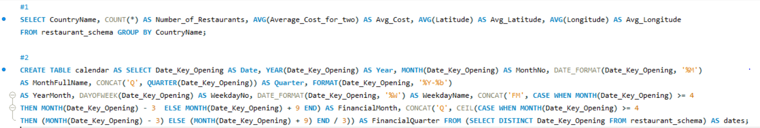
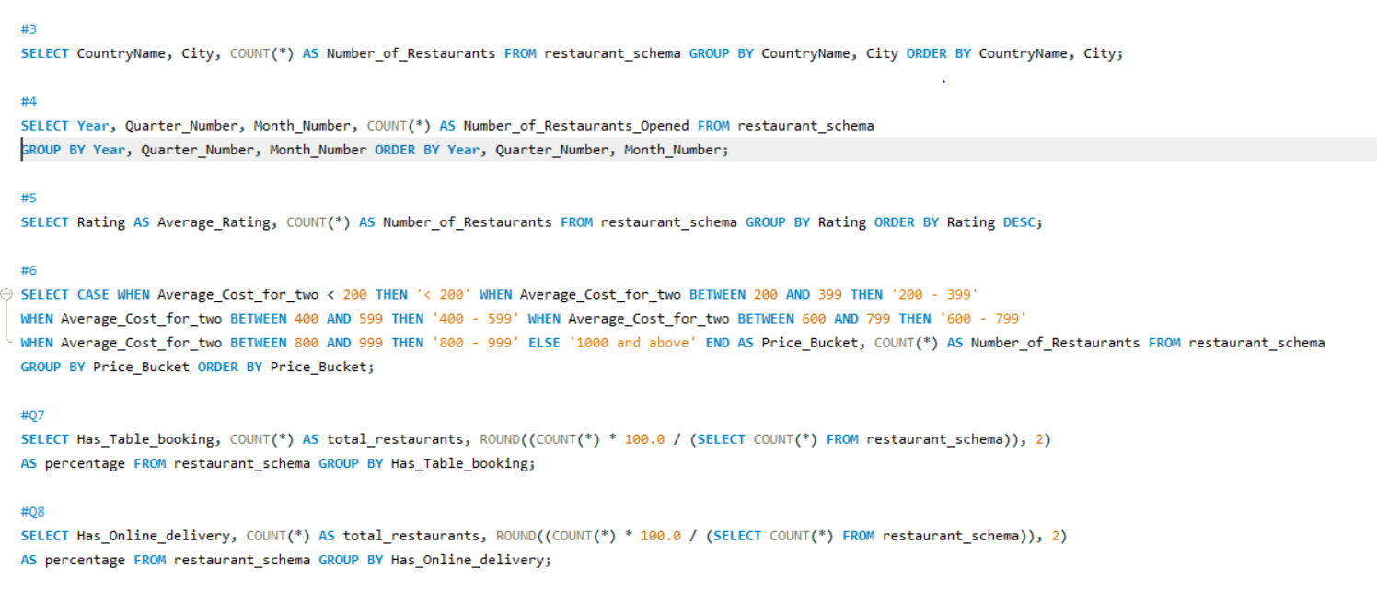
MYSQL QUERY
This SQL query analysis helps extract meaningful insights from restaurant data, enabling structured filtering, aggregation, and optimization for better decision-making. By using joins, subqueries, and indexing, SQL efficiently processes large datasets, supporting trends in service availability, pricing, and customer ratings.

Slide 7
KEY Insights OF DASHBOARDS
Service Availability Gaps – Most restaurants do not offer table booking (87.88%) or online delivery (74.34%), limiting customer convenience.
Online Delivery Impact – Restaurants with online delivery have higher ratings (3.3) compared to non-delivery ones (2.8), showing its positive influence on customer satisfaction.
Cuisine Preferences – North Indian cuisine dominates, followed by Chinese and Fast Food, indicating strong customer demand.
Restaurant Growth Trends – Openings fluctuate across months, suggesting seasonal market influences on restaurant launches.
Pricing Trends – Most restaurants fall within the affordable price range, showing a preference for budget-friendly dining.
Top Performing Brands: Cafe Coffee Day, Subway, Domino’s Pizza, and McDonald’s rank among the best-performing restaurants.

Slide 8
Recommendations
Expand Online Delivery Services: Encourage more restaurants to offer delivery, as it correlates with higher customer ratings.
Increase Table Booking Availability: Promoting reservations can enhance customer experience and restaurant efficiency.
Leverage Popular Cuisines: Restaurants should focus on North Indian and Chinese cuisine to attract more customers.
Analyze Growth Patterns: Understanding seasonal trends in restaurant openings can help optimize expansion strategies.
Highlight Top Brands: Use high-performing restaurants in promotions to boost engagement and attract more customers.

Slide 9
CONSLUSION
These dashboards provide a clear understanding of restaurant trends, focusing on service availability, pricing, cuisine preferences, and customer ratings. Key insights reveal growth opportunities in online delivery, gaps in table booking, and strong demand for specific cuisines. Businesses can use this data to enhance customer experience, optimize operations, and drive strategic expansion in the restaurant industry.

